Slide 2
Oracle Global Leaders Program
Americas, 2018
Laura McKechnie
Director, Business Development, Oracle Global Leaders Program
DW & Big Data Product Management

Slide 3

Oracle Global Leaders Program
What?
Oracle Development led program, sponsored by Database Executive Management
1:1 relationship with customers and partners
Support and education in implementation of hot products such as ‘autonomous data warehouse’ and big data (Information Management)
Drive customer interaction and networking
Cultivate reference customers
Perpetual

Slide 4
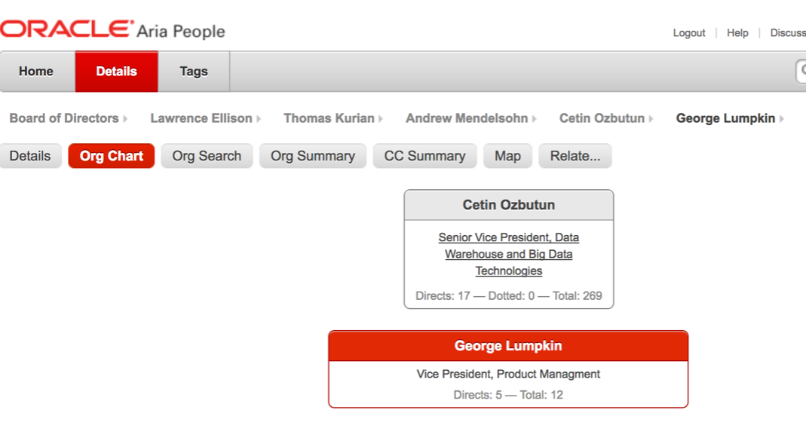

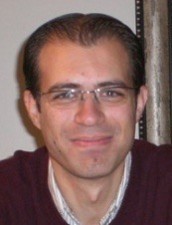
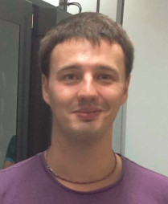
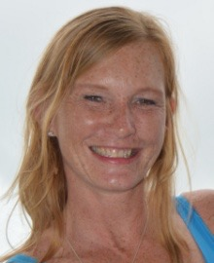
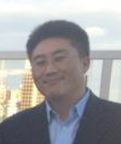
Oracle Global Leaders Program
Who are we?
Reiner Zimmermann Cemil Alper Alexey Filanovisky Laura McKechnie Matthew Kim

Slide 5

















































































































































Oracle Global Leaders Worldwide

Slide 6




Oracle Global Leaders Program
The three pillars
Educate
&
Support
Feedback
&
Roadmap
Meeting
& Share
Oracle Global Leaders Program

Slide 7






Oracle Global Leaders Program
The three pillars - 1. Meeting and Sharing

Slide 8



Worldwide Global Leaders Meeting
Oracle Global Leaders Program
Excellence Awards
DW & Big Data Leader of the Year
Cloud Architect of the Year
CDO of the Year

Slide 9


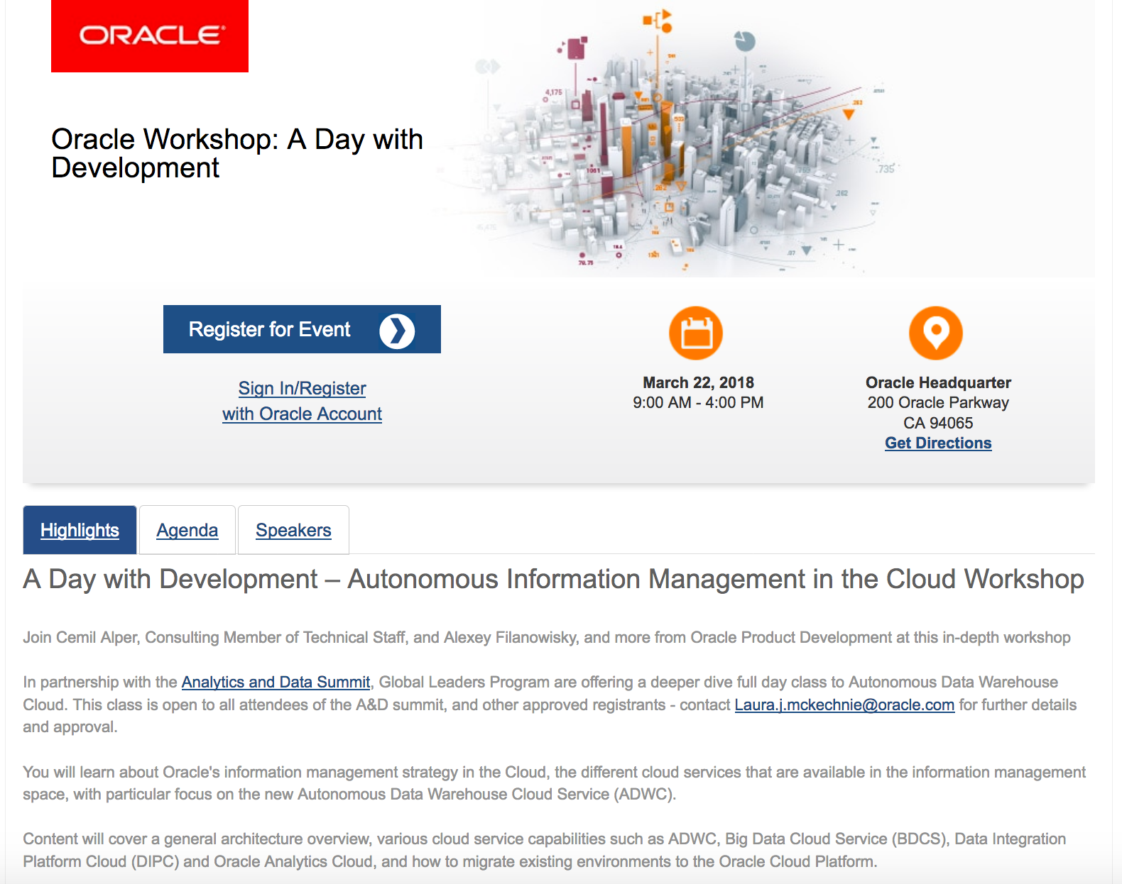
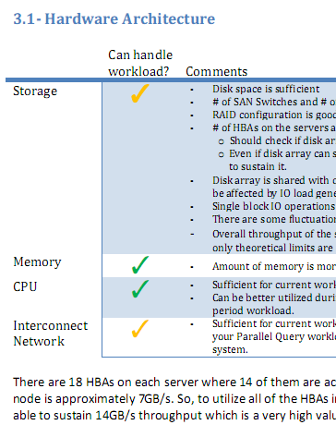
Oracle Global Leaders Program
The three pillars - 2. Educate and Support
Autonomous Database
Beta/Early Adopter Programs
Day with Development
Healthchecks/ 1:1
Customer & Product Webinars

Slide 10



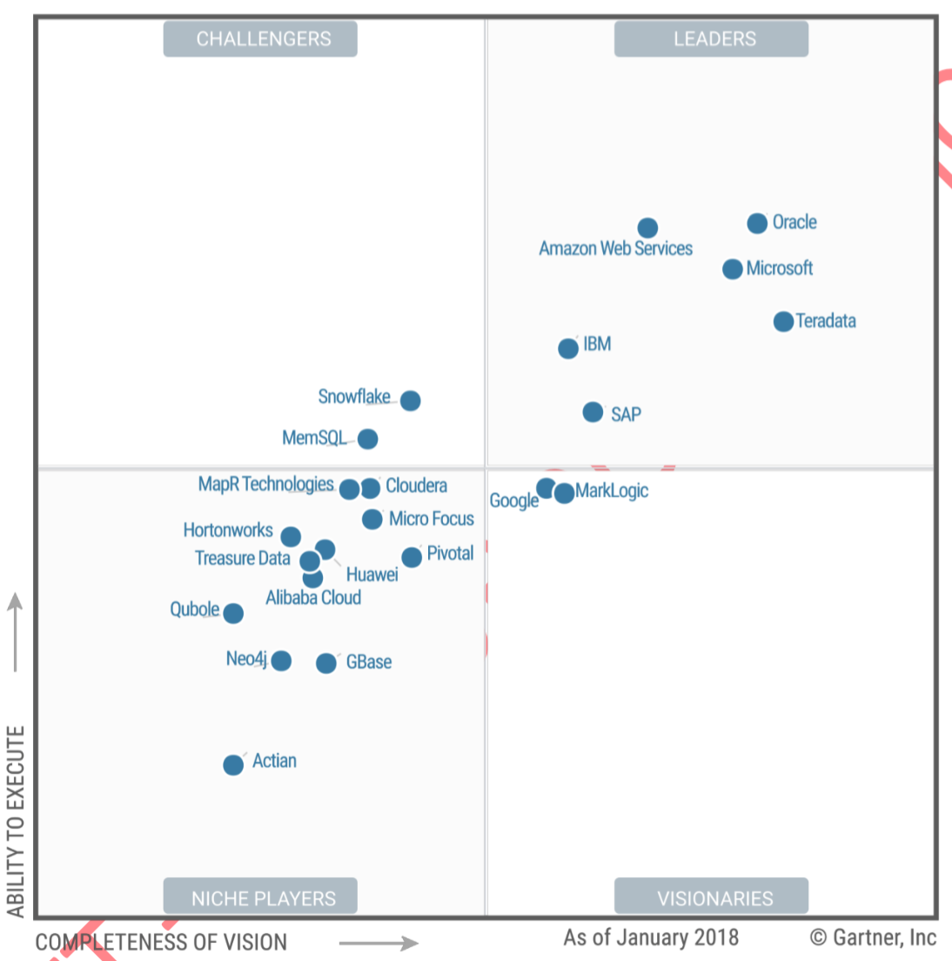



Oracle Data Global Leaders Program
The three pillars - 3. Feedback and Roadmap
Gartner Peer Insights Survey Link
http://gtnr.it/2uitT5K
Oracle Global Leaders Program

Slide 11



Our Next Americas Global Leaders Meeting ?
Global Leaders Program
Winter Meeting 2019
January 16th-17th
Miami, FL

Slide 12
Call to Action
Tell customers about program -
Invite to OW event – Thursday 25th October
Mention Miami Event - 16/17th January 2018 - Conrad Miami Hotel
Contact: Laura.j.mckechnie@oracle.com with prospects/ for approval
Oracle attendees by invitation only, or where accompanying 3+ new accounts

